Slide 1
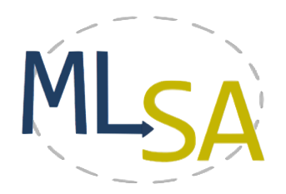

Lightweight Call-Graph Construction for Multilingual Software Analysis
Anne Marie Bogar¹, Damian M. Lyons¹ and David Baird²
¹Department of Computer & Information Science, Fordham University, New York NY USA
²Bloomberg L.P., New York NY USA
{dlyons,abogar}@fordham.edu, dbaird16@bloomberg.net
The authors acknowledge the contributions of
Sunand Raghupathi in building MLSA Tools
The authors are partially supported by grant DL-47359-15016 from Bloomberg L.P.

Slide 2
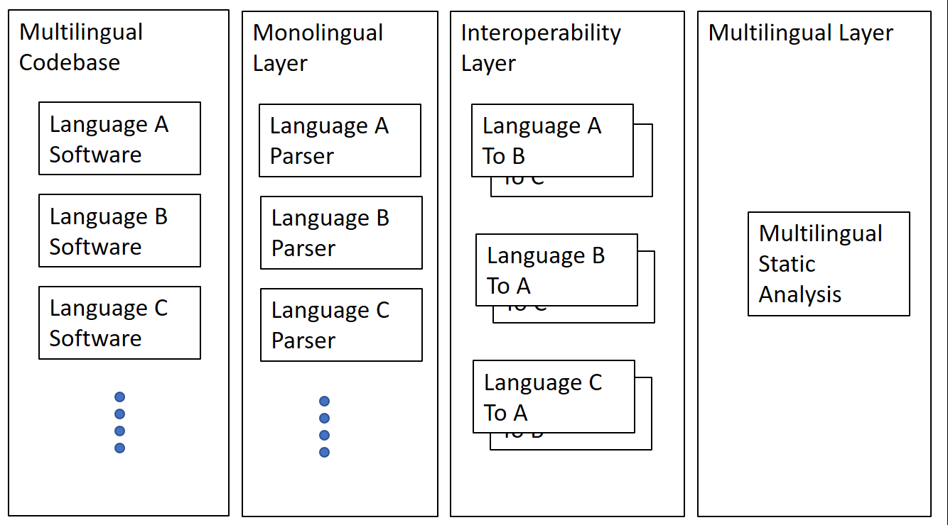
MultiLingual Static Analysis (MLSA) Architecture
Data flows left to right

Slide 3
Problem
Approaches
Dynamic Dispatch
Time consuming to parse
Inadequate handling of pointers and classes
CHA
RTA
XTA
Eclipse
Doxygen

Slide 4
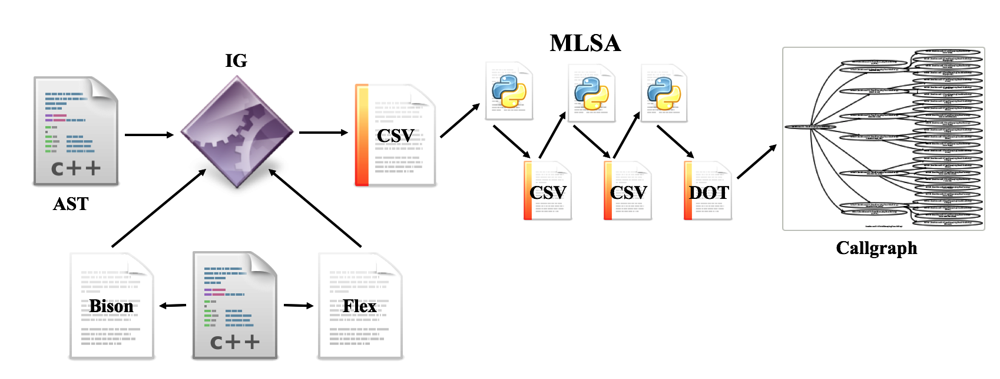
The PAIGE Approach (Parsing AST Using Island Grammar Call Graph Emitter)
Lightweight: Leverage existing software to extract the required information from source code.
Modular: Process the extracted information in a manner that is not bound to a specific language.
Static Analysis: All potential calls are captured rather than the subset seen in any single run.

Slide 5
The PAIGE Approach (Parsing AST Using Island Grammar Call Graph Emitter)
Abstract Syntax Tree
Organizes code into standard nodes with readily available information for each node (i.e. line number, block type, class member…)
Blocks of nodes in easy-to-parse format
Using pre-generated ASTs ensures that the AST will have a standard structure and a standard amount of information for each program

Slide 6
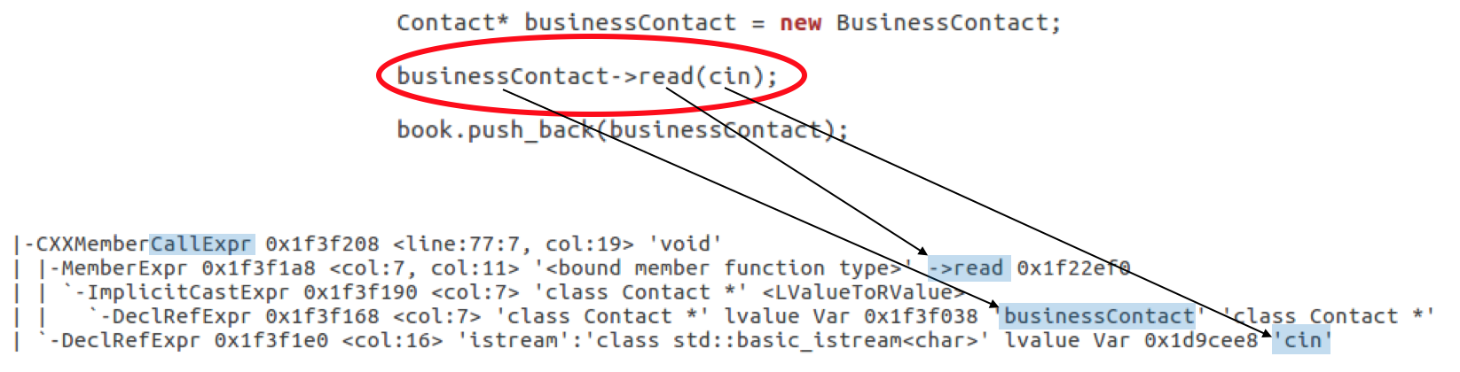
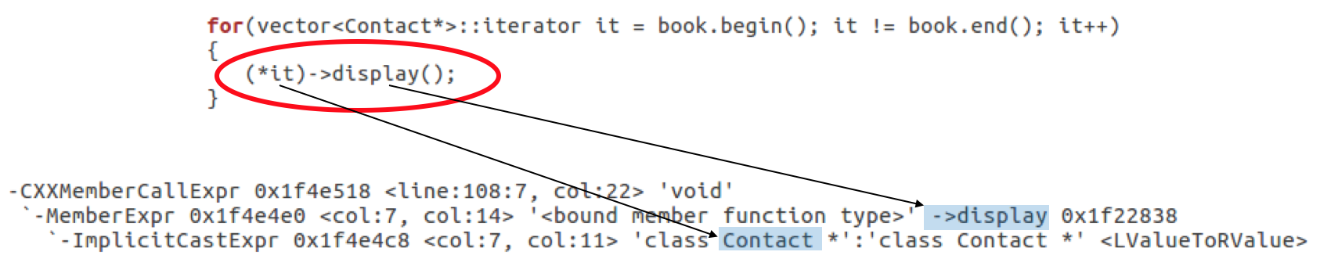
The PAIGE Approach (Parsing AST Using Island Grammar Call Graph Emitter)

Slide 7
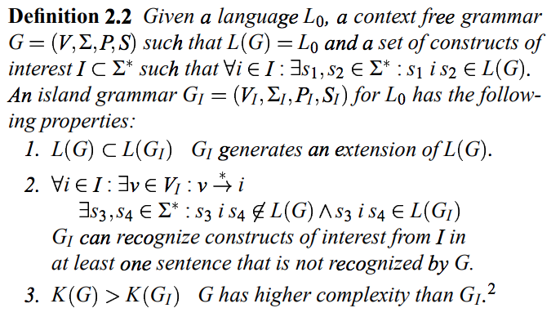
The PAIGE Approach (Parsing AST Using Island Grammar Call Graph Emitter)

Slide 8
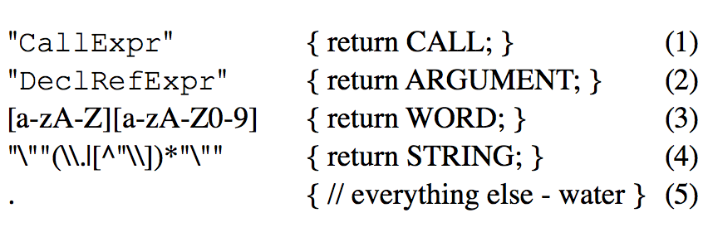
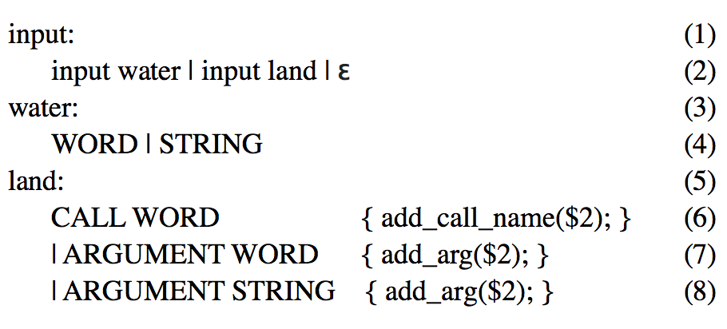
The PAIGE Approach (Parsing AST Using Island Grammar Call Graph Emitter)
← Flex (lexicon)
Bison (syntax) →

Slide 9
The PAIGE Approach (Parsing AST Using Island Grammar Call Graph Emitter)
Call graph analysis (CGA) is a useful software engineering tool
In particular, for multilingual code, the call graph can be used to investigate the boundary line between languages, a boundary that is opaque in many tools.

Slide 10
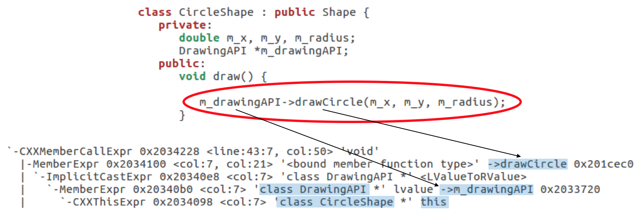
Advantages and Drawbacks of PAIGE
Advantages
Drawbacks
this pointer
Arguments for multilingual use
Pre-generated AST may not handle all cases
Template classes
Polymorphism

Slide 11
Questions?
TWiki – https://goo.gl/6mvyNS
GitHub – https://git.io/MLSA
Email – multilingualsa@gmail.com
YouTube – https://goo.gl/g8ra15

